Slide 1

Integrand Reduction reloaded; Algebraic geometry and finite fields
Ray D. Sameshima
New York City College of Technology
CUNY Graduate Center
Ph. D. Advisors: Andrea Ferroglia, Giovanni Ossola
Work done in collaboration with:
P. Mastrolia, A. Primo, W. J. T. Bobadilla(University of Padova),
T. Peraro (University of Edinburgh)
and
A. Broggio (Technische Universität München)
B. D. Pecjak (Durham University)
Supported in part by NSF Grant PHY-1417354

Slide 2

An Outline
Scattering amplitudes, integral and integrand decompositions
Integrand level decomposition with algebraic geometry
Analytic expression from numerical evaluation by means of finite fields
First steps towards implementation
Top quark physics

Slide 3
What is a scattering amplitude?
A connection between collider experiments and theoretical models.
A scattering amplitude is a probability amplitude, and the cross section is derived from it.
In fact, it (the cross section) is the effective area of a chunk taken out of one beam, … (Peskin and Schroeder)
(LHC, for example)

Slide 4
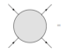
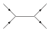
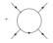
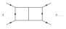
Leading Order, Next Leading Order, and higher
A scattering amplitude is computed using a perturbation series:
To understand interactions more deeply and to compare with experiments more accurately, it is required to reduce the theoretical uncertainty.
This will be achieved by taking higher loop amplitudes.

Slide 5
The flow of automation
Generation
Reduction
Evaluation

Slide 6
The flow of automation
Generation
Reduction
Evaluation
“Draw Feynman diagrams”
Given an event, e.g., 2-2 scattering,
generate Feynman diagrams up to certain order.
This is achieved recursively, i.e., add vertices,
virtual lines, and real emissions
on the lower order diagrams.

Slide 7
The flow of automation
Generation
Reduction
Evaluation
Reduce each diagram into the sum of
Master Integrals.
OPP method as a standard algorithm.
“partial fraction expansion”

Slide 8
The flow of automation
Generation
Reduction
Evaluation
Integration: brute force computation,
Integral By Parts technique,
differential equation etc.

Slide 9
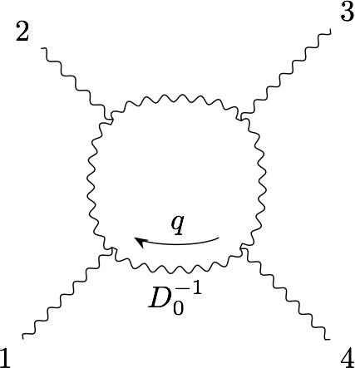
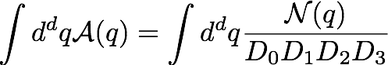
An Example
A one-loop 2 → 2 scattering diagram is depicted as
We translate it into an integral form using Feynman rules given by the theory we consider:
Here the numerator function depends on the theory we consider, but once we draw a diagram then we can write its expression.

Slide 10
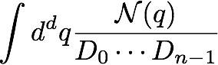
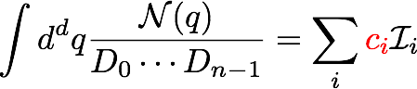
Integral-level reduction
Consider 1-loop Feynman integral with n denominators
The integral-level reduction leads to an expression in terms of Master Integrals which are easier to evaluate than the original integral above:
If Master Integrals are known, all we need is to extract the coefficients (c’s) that are given as rational functions of kinematics.

Slide 11
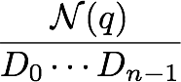
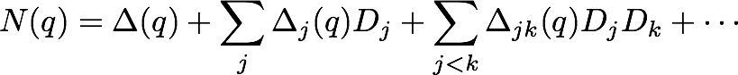
Integrand-level reduction
Alternatively, we can reduce the integral kernel before integration.
Integrand reduction allows us to fit the numerators as the following polynomial form
This expression allows us to compute all coefficients in a straightforward manner.
The multivariate polynomial division is a systematic way of the integrand reduction.
G. Ossola, C. G. Papadopoulos and R. Pittau, Nucl. Phys B 763, 147 (2007).
P. Mastrolia and G. Ossola, JHEP 1111, 014 (2011).
P. Mastrolia, E. Mirabella, G. Ossola and T. Peraro, Phys. Lett. B718 (2012).

Slide 12
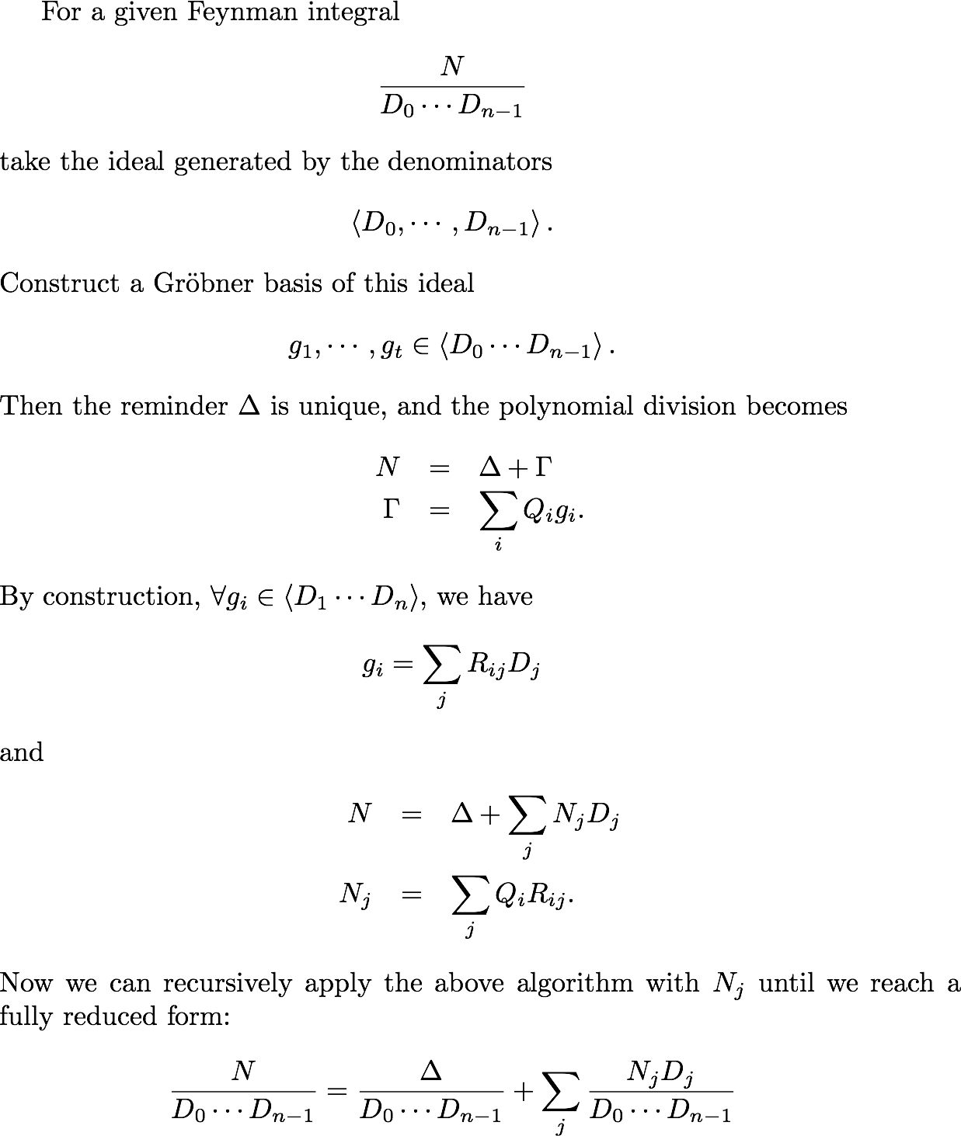
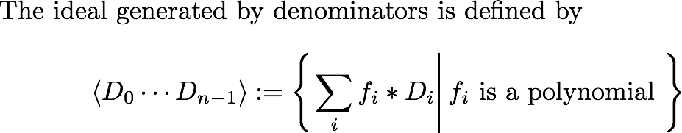
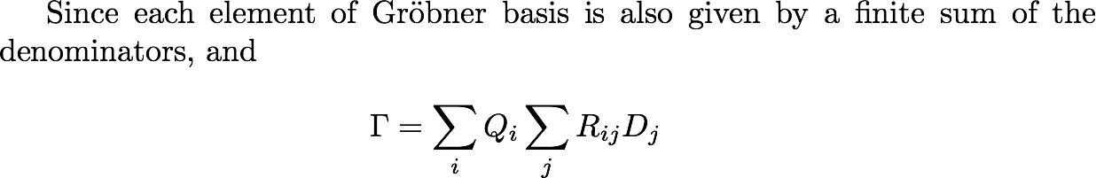
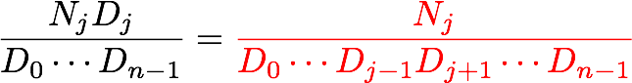
An algorithmic recipe:
Recursive algorithm
P. Mastrolia, E. Mirabella, G. Ossola and T. Peraro, Phys. Lett. B718 (2012).

Slide 13
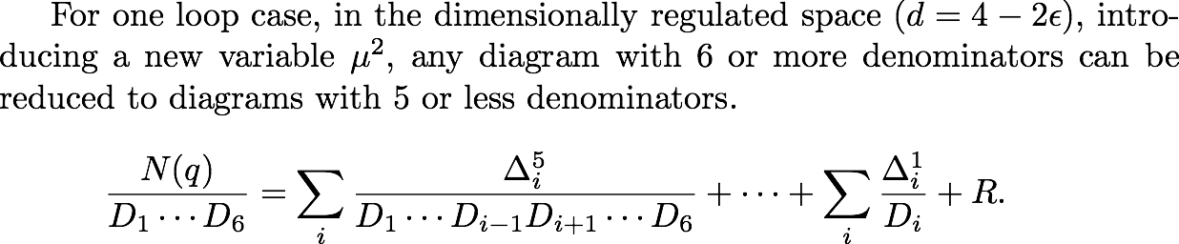
Facts
This equality holds integrand level, so as integral level.
Algebraic geometry also provides a systematic way of the proof.
P. Mastrolia, E. Mirabella, G. Ossola and T. Peraro, Phys. Lett. B718 (2012).

Slide 14
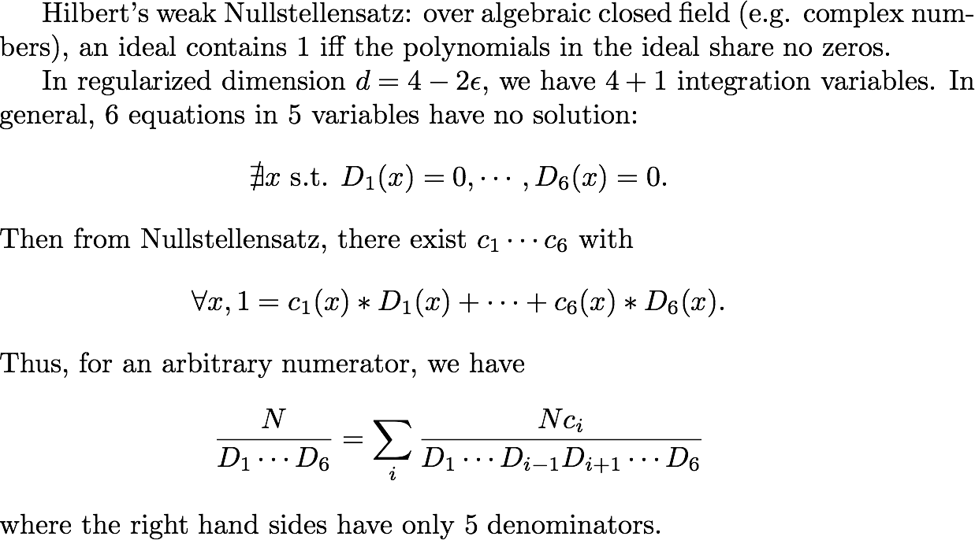
Outline of the proof
Over constraints !

Slide 15
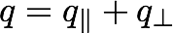
Toward new efficient algorithms
Integrand reduction method makes problem and its solution clear, but it requires to generate a Gröbner basis for each diagram.
A new algorithm (adaptive integrand decomposition) has been published recently, which enable to reduce the numerator using clever choice of momentum basis without generating Gröbner basis. This also can reduce the number of parameters for denominators.
P. Mastrolia, T. Peraro and A. Primo, JHEP 1680, 164(2016)

Slide 16
functional reconstruction
There are a list of well-tested numerical implementations for the evaluation of one-loop Feynman Integrals.
Can we extract analytic expression from them?
Given sufficient input-output data, we can reconstruct the generic, analytic expressions for these integrands.
Newton interpolation for polynomials
Thiele interpolation for rational functions
Samurai, Ninja, Golem,…
Introduction to Numerical Analysis (J. Storer, R. Bulirsch )

Slide 17
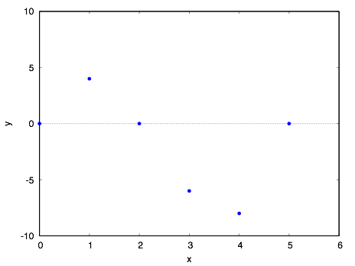

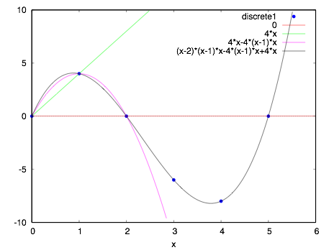
Functional reconstruction
Curve fitting; exact coincidence with the smallest degree as the weights
Finite difference analysis (finite version of differential analysis)
What ?
the order and each coefficient

Slide 18
why?
Cheaper numerical evaluation (everything is numeric, not symbolic)
Existing platforms (blackbox interpolation)
Hidden redundancy
both space and time in computers
Reconstructed functions are fully reduced form.

Slide 19
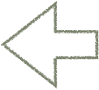
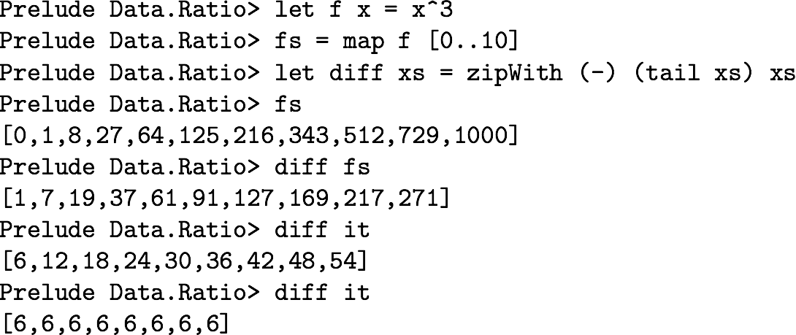
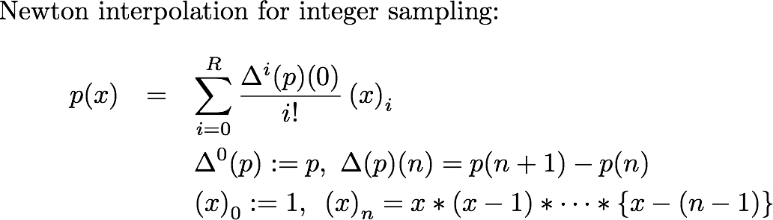


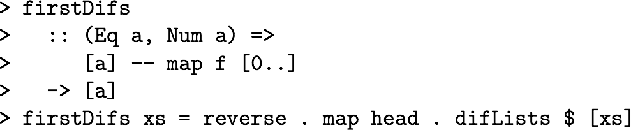
functional reconstruction Newton’s algorithm
The first differences are constructed from the functional values.
Difference analysis
Haskell Road to Logic, Maths and Programming, Kees Doets and Jan van Eijck, 2004.

Slide 20
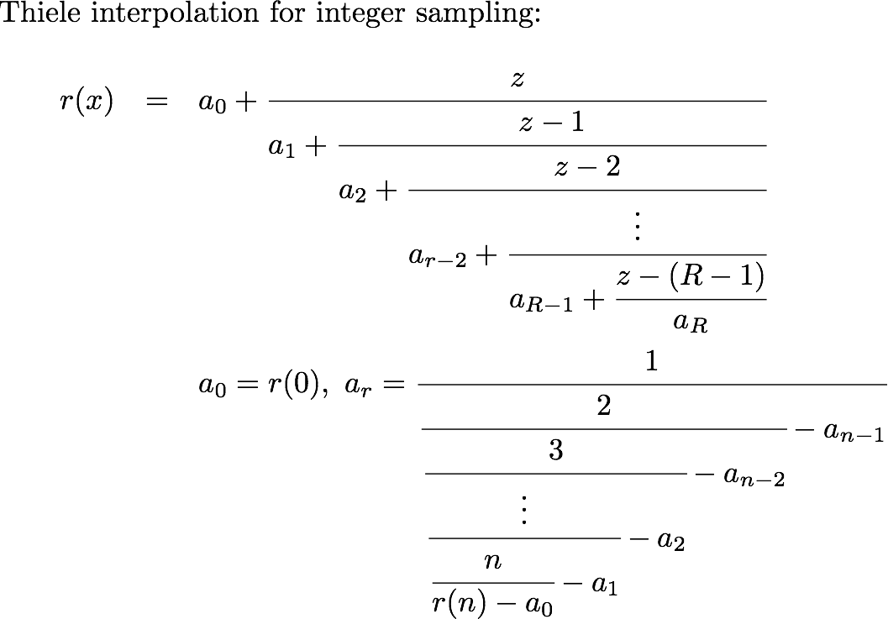


functional reconstruction Thiele’s algorithm
Continuous fraction form
Inverse differences are also given by the functional values.

Slide 21
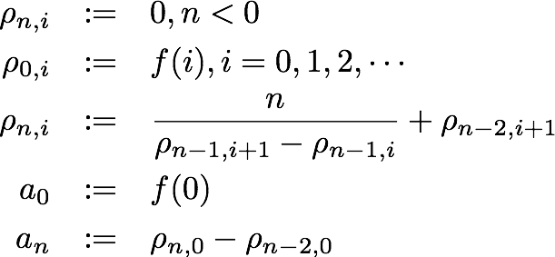
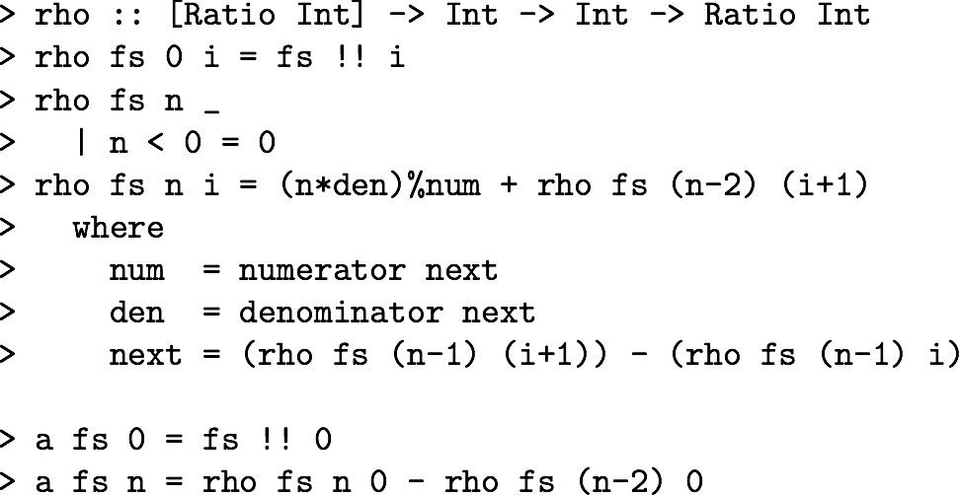
Reciprocal difference
Introducing the reciprocal differences which are closely related to the inverse difference:
Haskell definition
Mathematical definition

Slide 22

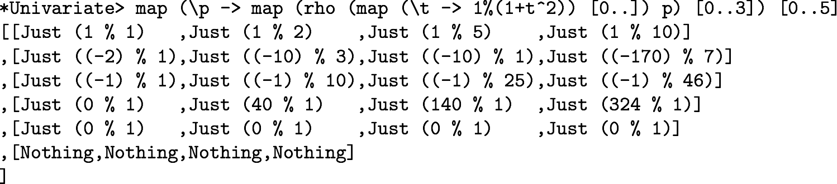
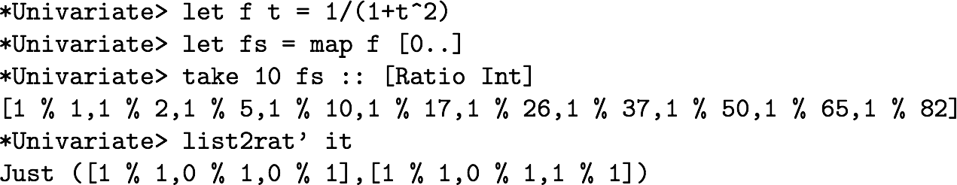
Rational function reconstruction
Consider this function, and pretend we do not know its canonical form.
The 1st row is the outputs of integers.
4th row is constant sequence, and 5th is infinity
Take first 10 out puts as the accessible data.
This outcomes are the list of coefficients, numerator and denominator.

Slide 23
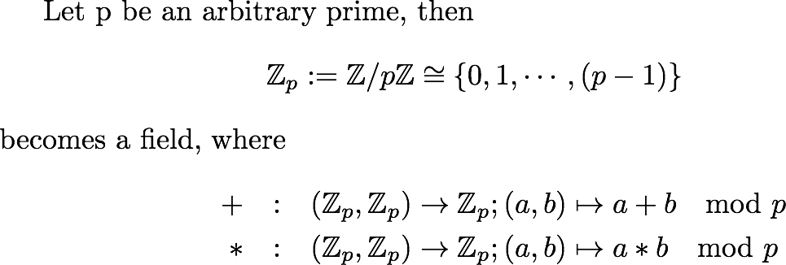
Finite fields; an efficient way of reconstruction
Some numerical algorithms can be solved efficiently over finite fields, i.e., prime fields.
We map our problems and solve on finite fields, then we remap them to rational field with high probability.
P. S . Wang, SYMSAC ’81, ACM, 1981
T. Peraro, JHEP 1612 (2016) 030

Slide 24
functional reconstruction over a finite filed
Keep away from infinity!
Treatment of singular and fake-singular
Reconstruct functions (formally) on finite fields
Re-map them into rational fields using Chinese Remainder Theorem
1/p is the other form of singularity on Z_p.
Each coefficient is Z_p value.
Rational number reconstruction for coefficients.
P. S . Wang, SYMSAC ’81, ACM, 1981
T. Peraro, JHEP 1612 (2016) 030

Slide 25
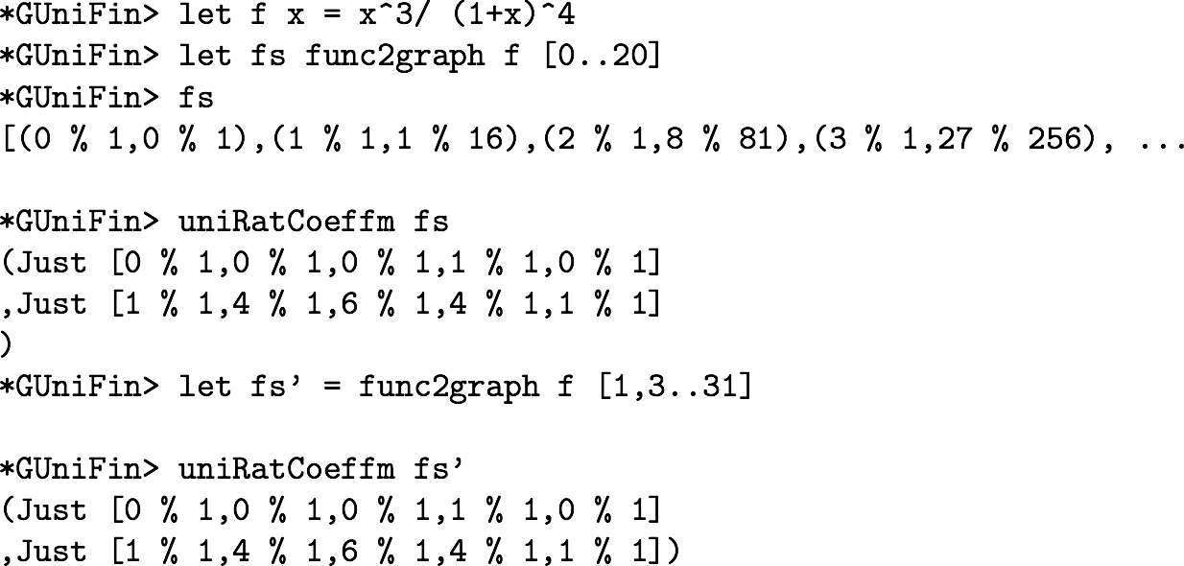
example
1 variable case
A finite subgraph of given function
Different set of inputs

Slide 26
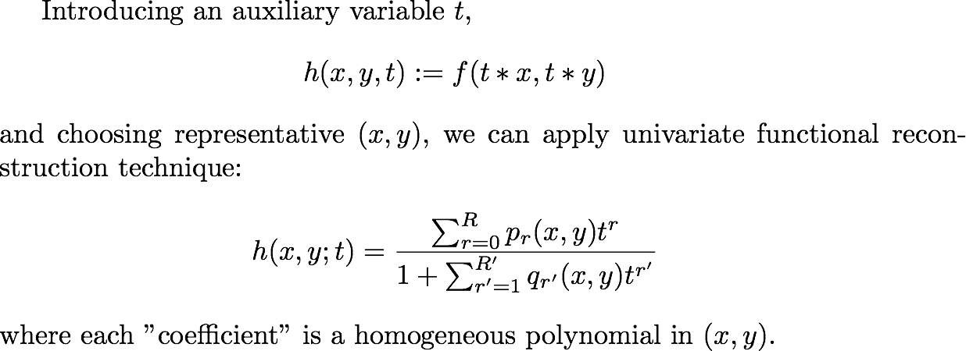
Multivariate functions
2 variable case
Term by term application of reconstruction
Recursively!

Slide 27
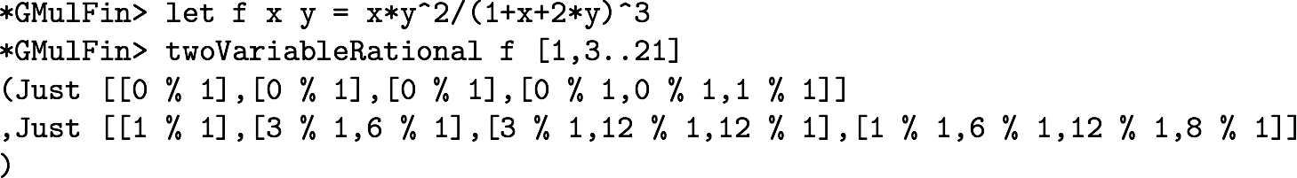
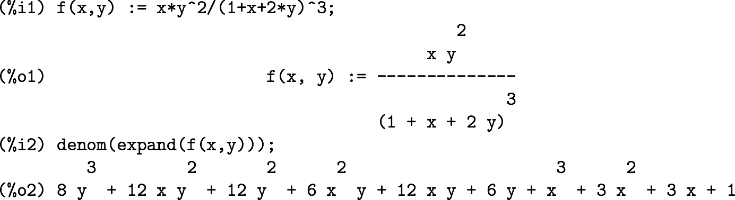




example
The coefficient for x and y.
The coefficient for x^2, x*y and y^2.
Each sub-list corresponds to the homogeneous order.
Maxima

Slide 28
problems
Expressions for functions on computer systems
Treatments for singularities
Heavy, multi layered recursion (nested loop)
Modification of the problem
List (recursive data structure), borrow the existing plat forms
Interfaces (Error handling, IO, etc)
Better data structure, linear solver (Gaussian elimination)
Functions on machine size integers v.s. coefficients of machine size integers

Slide 29
toward higher loops and implementations
We aim to build a fully automation for the evaluation of Feynman integrals with 2 or more loops, with adaptive integrand decomposition algorithm, using combinations of numerical evaluations and reconstructions over finite fields.
The reconstruction codes can also provide analytic expression for generic processes.
Work in progress with
P. Mastrolia, A. Primo, W. J. T. Bobadilla(University of Padova),
T. Peraro (University of Edinburgh)

Slide 30
Background works
LO calculations for ttW and ttZ with FORM
Numerical verification with Maxima
NLO calculations with MG_5 on the cluster system of City Tech
Generation and Evaluation

Slide 31
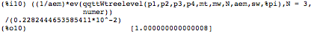
Background works
Analytic computation for LO ttW and ttZ with FORM
“Draw” Feynman diagrams with FORM syntax,
calculate cross section analytically
Numerical verification on Maxima
On Maxima, substitute several phase space points to analytic expression from FORM
For a randomly chosen phase point, I compare my own calculation with that of Professor Ferroglia’s calculation.
The ratio is 1 plus machine epsilon.

Slide 32
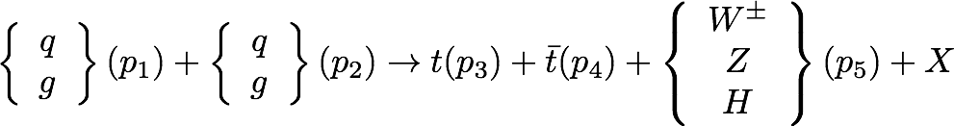
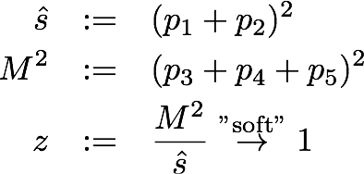
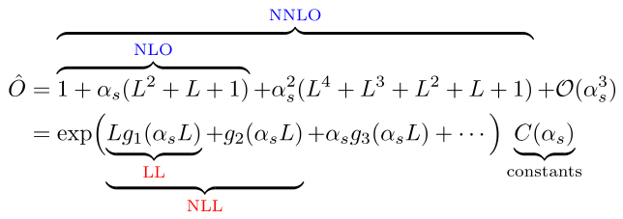
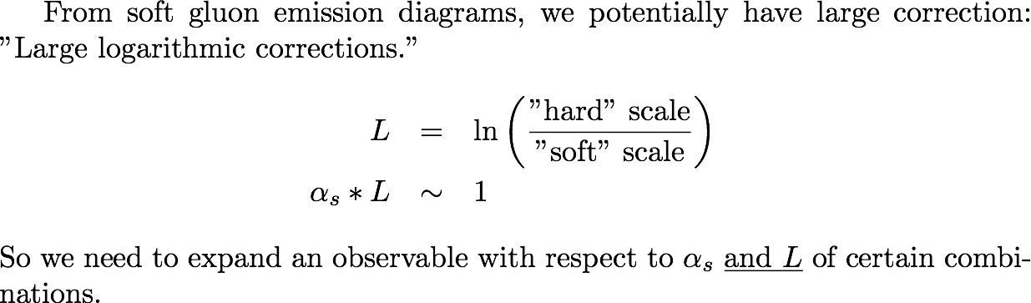
top pair physics
JHEP 1704 (2017) 105
Associated production of a top pair and a Z boson at the LHC to NNLL accuracy
(A. Broggio, A. Ferroglia, G. Ossola, B.D. Pecjak and RDS)
Partonic process

Slide 33

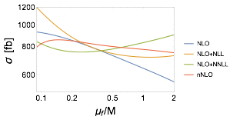
top pair physics
To see how q-g ch contributes to the scale uncertainty
M/4, M/2 and M
For fixed order calculation, total cross sections depend on the factorization scale.
We choose this scale so that different perturbative approximations are not so different.
Results:
from NLO to NLO +NNLL accuracy, both total cross sections and differential distributions of ttZ increase, and theoretical uncertainties becomes smaller.

Slide 34
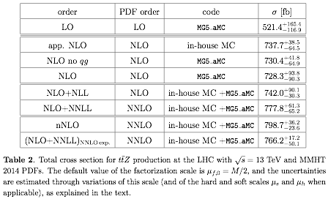

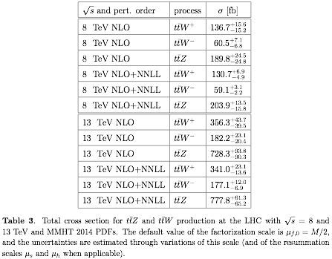

top pair physics
ttZ total cross section at 13 TeV
ttW total cross section at 13 TeV

Slide 35
summary
Integral-level(integral) and integrand-level(polynomial)
Algebraic geometry as tools, and a new algorithm for decomposition
The usage of finite fields in reconstruction
Toward implementations
Top quark physics

Slide 37
Adaptive Integrand Decomposition
Clever choice of parameter for momentum space reveals, so called, spurious terms which will vanish under integration.
This choice makes the polynomial division problems into a set of liner equation.
P. Mastrolia, T. Peraro and A. Primo, JHEP 1680, 164(2016)

Slide 38
Groebner bases
unique remainder
iff condition for ideal membership
generating algorithm (Buchberger, F4, etc.)
Properties
Ideals, varieties, and algorithms (Cox, Littele, and O’Shea)

Slide 39
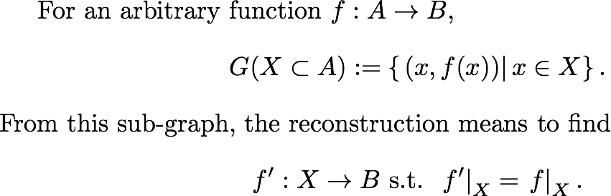
Reconstruction
Black-box problem, i.e., we can access only input-output data.
From the table of in-out, i.e., a sub-graph of the function, we build the function itself.

Slide 40
over finite fields
For efficiency, but it can also prevent from the machine size integer overflow.
Extended Euclidean algorithm as a constructive proof for Bezöut's lemma
Chinese remainder theorem
Rational number reconstruction for coefficients.
P. S . Wang, SYMSAC ’81, ACM, 1981
T. Peraro, JHEP 1612 (2016) 030

Slide 41
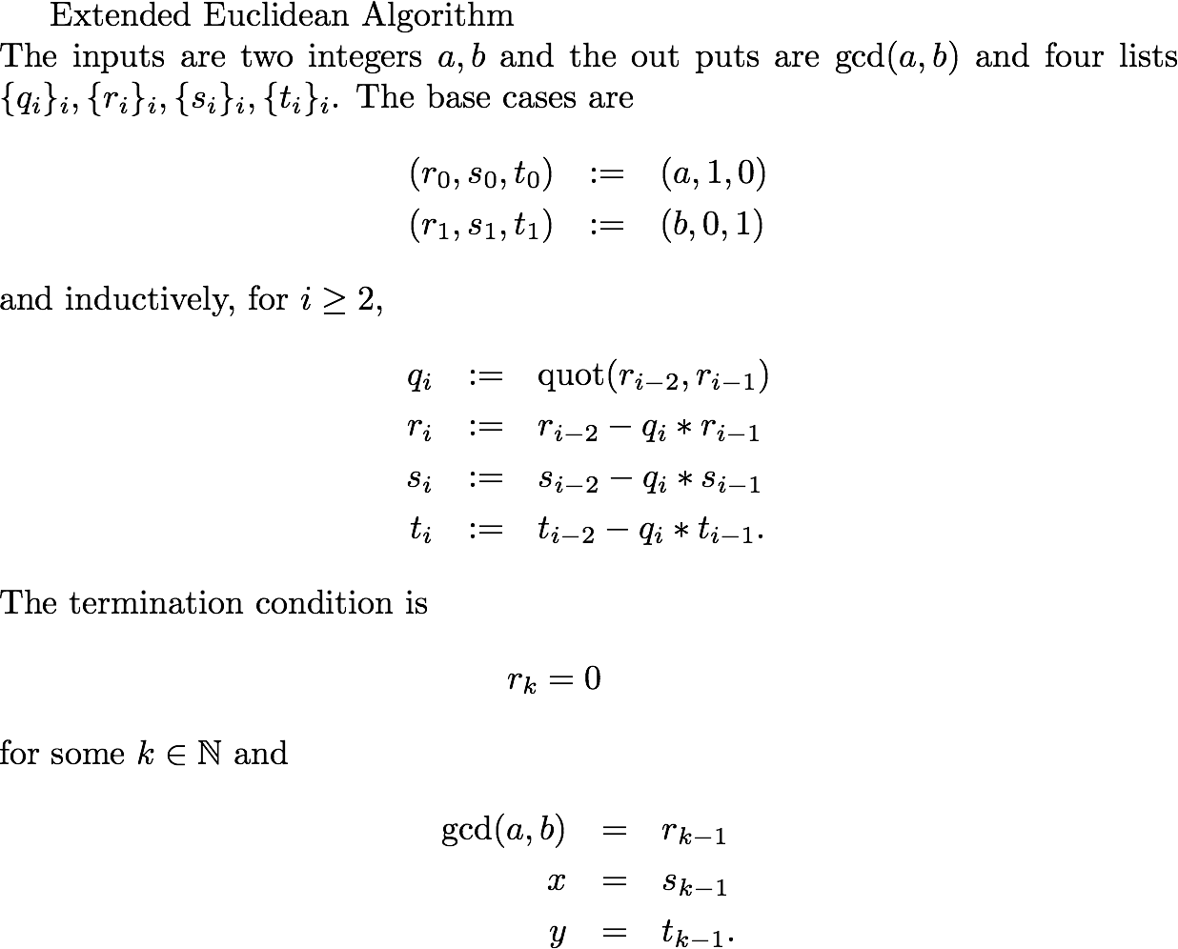
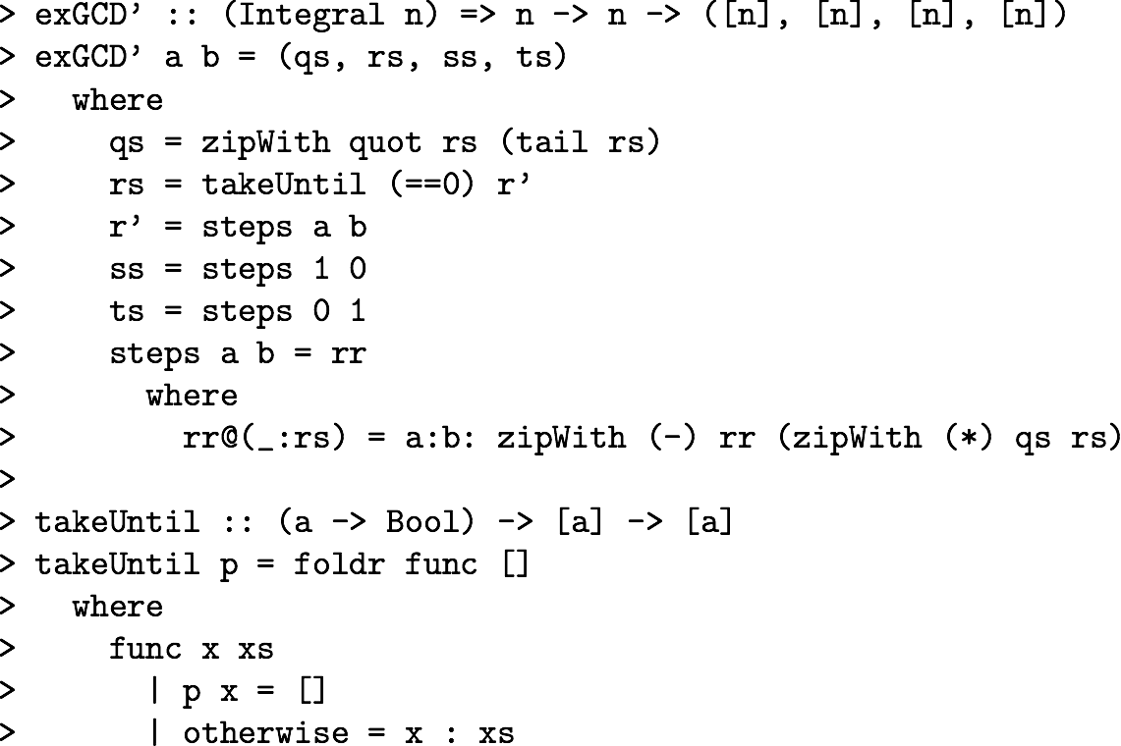
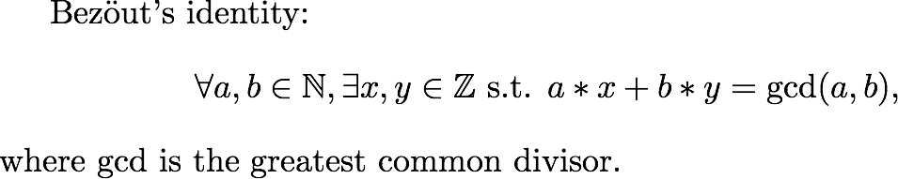
EEA with Haskell code

Slide 42
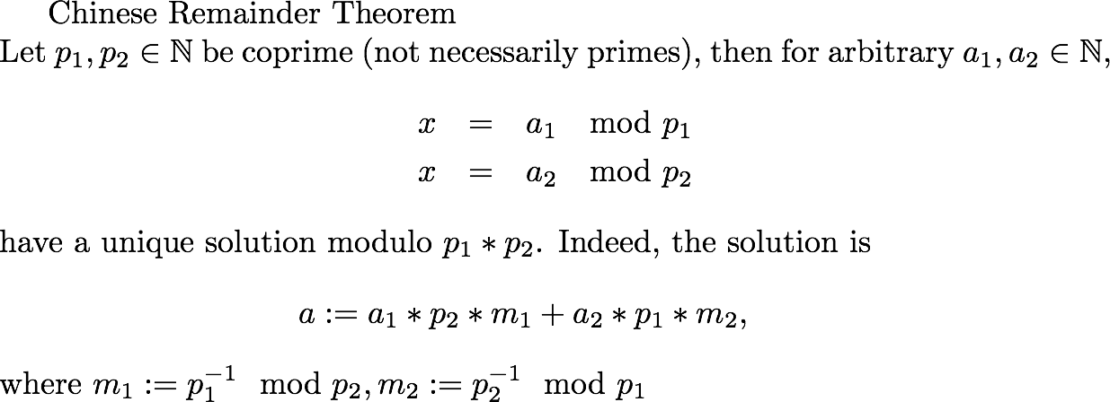
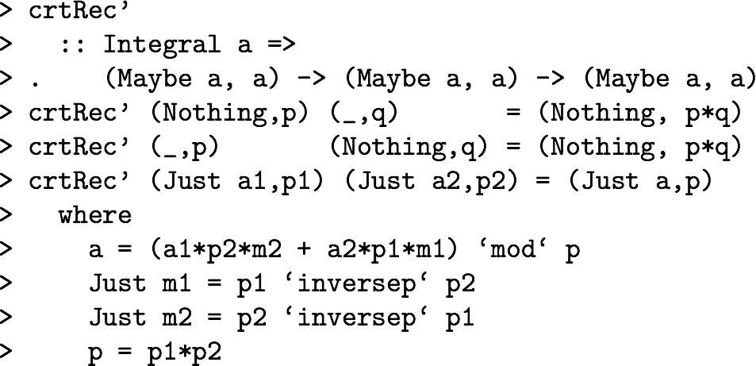
crt with Haskell code
This can merge several prime fields into a quotient ring of big product.

Slide 43
Haskell language
A standardized purely functional lazy language for general purpose.
www.haskell.org
Haskell is a computer programming language.
In particular, it is a polymorphically statically typed, lazy, purely functional language, quite different from most other programming languages.
The language is named for Haskell Brooks Curry, whose work in mathematical logic serves as a foundation for functional languages.
Haskell is based on the lambda calculus, hence the lambda we use as a logo.
https://wiki.haskell.org/Introduction

Slide 44
Haskell
What (definition) v.s. How (procedure)
lambda calculus v.s. Turing machine
immutable and lazy

Slide 45
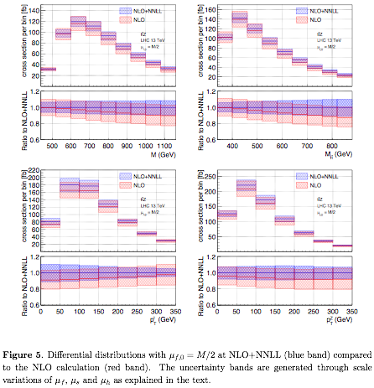
ttZ differential cross sections at 13 TeV

